Slide 1
Team Nasduck:
Final Project Presentation

Slide 2


Slide 3

Project: Netflix Stock Prediction
The task of forecasting stock price has been a challenge for many researchers and analysts for decades. Nonetheless, many investors are keen on knowing predicted stock prices to help them make more informed and good investment decisions.
Thus, effective prediction systems can provide beneficial information of the future direction of stock price, which in this case will be for Netflix stock price.

Slide 4
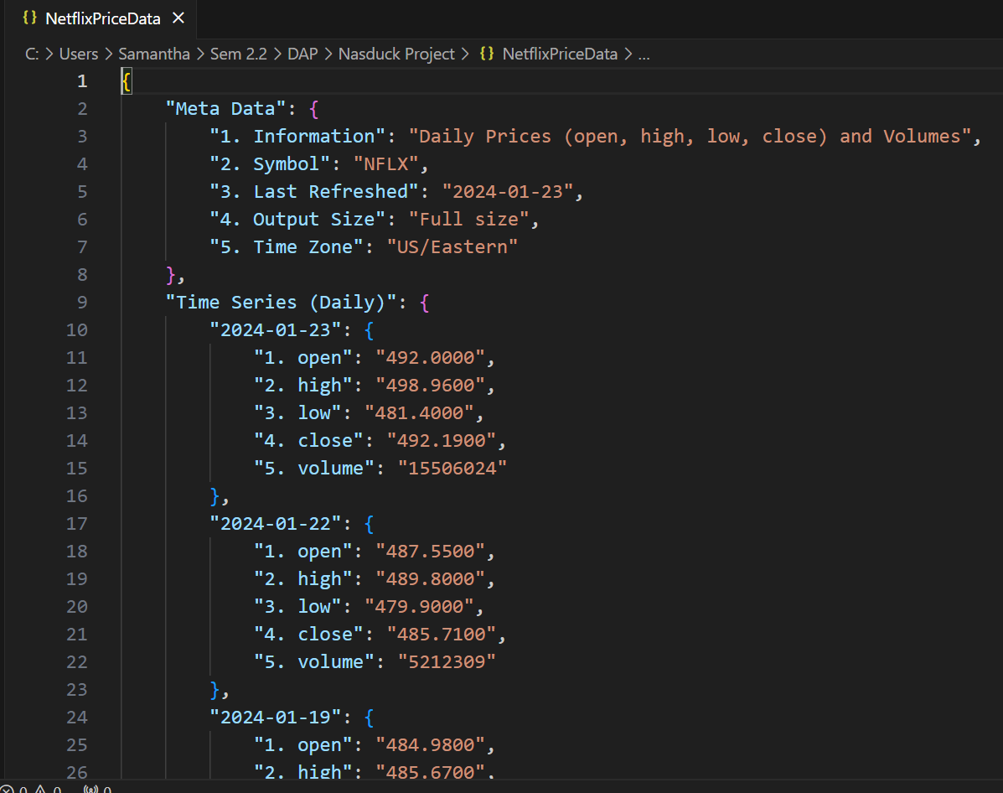
Netflix Stocks + SPY Data
Scraped data on stock prices from 1 Jan 2010
open, high, low, close, volume

Slide 5
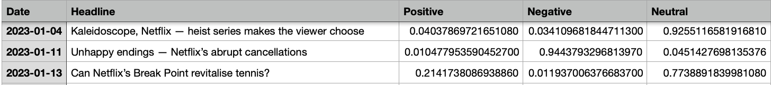
News headlines sentiments
Scraped data on Netflix-related headlines
Assign sentiment values of the headlines (Positive, Neutral, Negative)
Notes:
The code is using the FinBERT model, which is a pre-trained model for financial sentiment analysis. The model is loaded using the Hugging Face Transformers library, and it specifically uses the "ProsusAI/finbert" model. The Hugging Face Transformers library is an open-source library that provides a collection of pre-trained models and various tools for natural language processing (NLP) tasks. It is developed by Hugging Face, a company that specializes in natural language processing and provides a platform for sharing and collaborating on machine learning models. In the provided code snippet, the library is used in conjunction with the FinBERT model, which is a specific pre-trained model designed for financial sentiment analysis. FinBERT focuses on understanding sentiment in financial text, making it relevant for stock-related tasks.

Slide 6
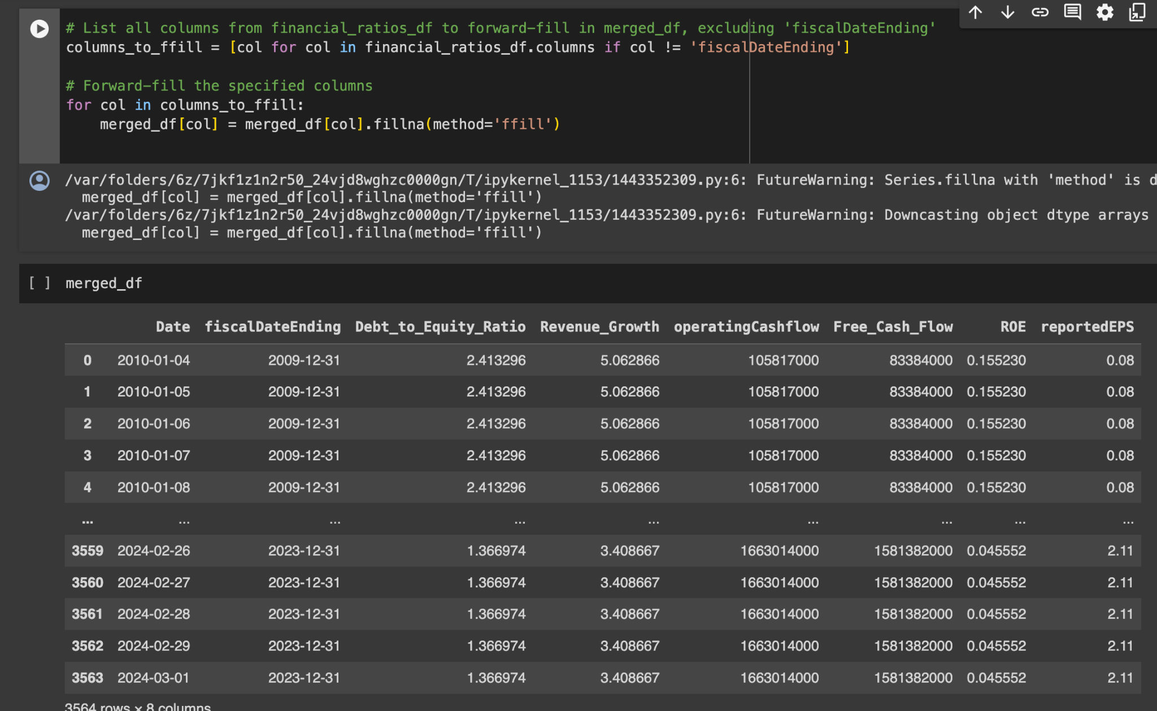
Financial Ratios
Incorporated Financial metrics such as:
Earnings Per Share (EPS)
Price-to-Earnings (P/E) Ration
Revenue Growth
Operating Cash Flow
Debt-to-Equity (D/E) Ratio
Free Cash Flow (FCE)
Return on Equity (ROE)
Data scraped from financial statements via AlphaVantage API
Cash Flow Statement
Balance Sheet
Income Statement
Forward-filled the quarterly data since main stock data used is daily

Slide 7
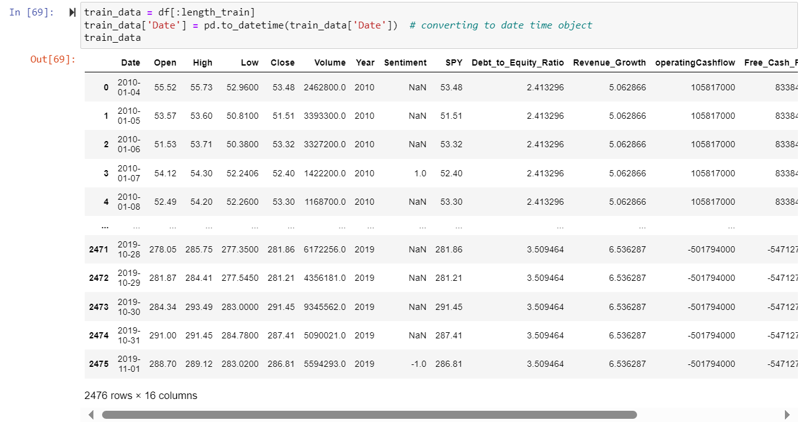
Dataset preparation
Filtered dataset for date ≥ 1 Jan 2010
Standardised dataset (from CSV, JSON) to Python Dataframe
Appended all the data collected

Slide 8
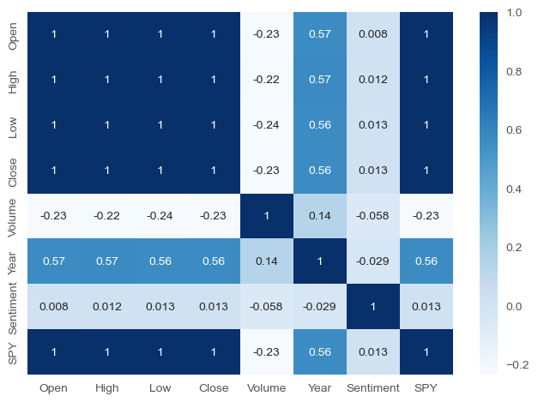
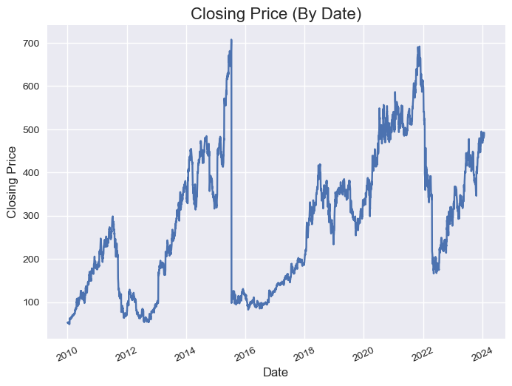
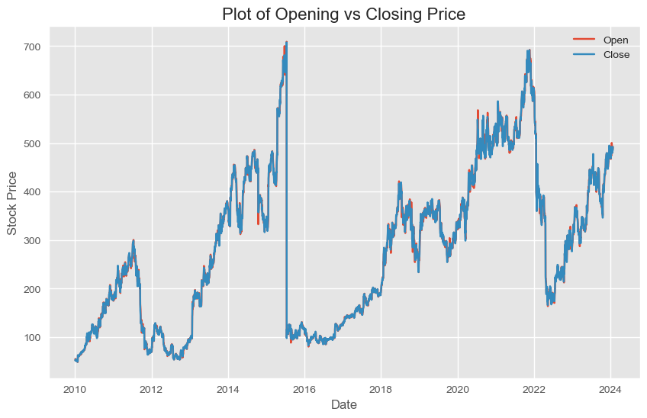
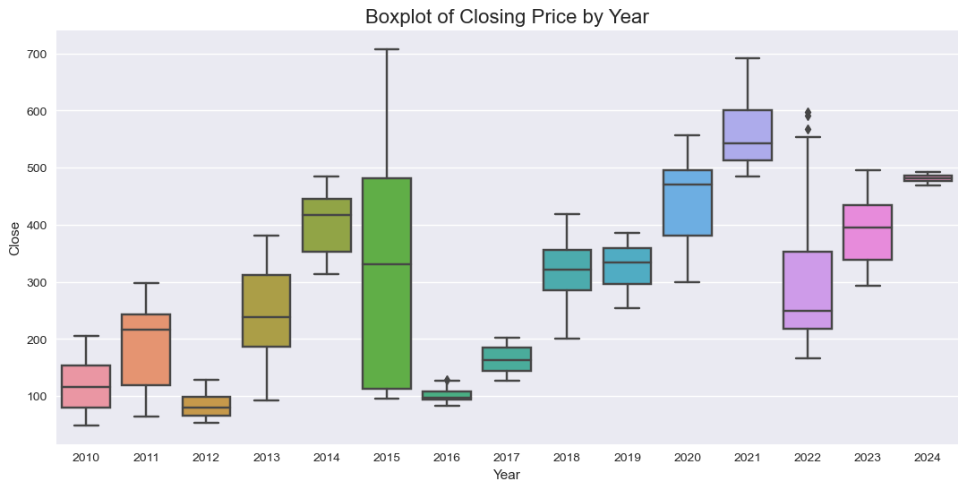
Exploratory Data Analysis
Using Seaborn and Matplotlib libraries
Notes:
Spikes in 2015 and 2021

Slide 9
Model used for the project
Time-series regression model
Neural Network models
LSTM
GRU
Notes:
So we explored with several models,
And since our project is a on stock prices, the data has to be in a sequential order because the stock prices are time sensitive, and that prompted us to explore mainly on time series regression as well as neural network models.

Slide 10
Technologies Used
Python Pandas for data pre-processing
Python Seaborn & Matplotlib for data visualisation
ARIMA & SARIMAX for time series regression
TensorFlow for LSTM / GRU / future models

Slide 11
Finding the right model
Standardised our input and training methods to allow for fair comparison between models
Data normalisation (Min-Max scaler)
Time-based split of training and testing data (70%-30%)
Number of layers, epoch, and batch size
Training variables
Task: to predict next-day closing price of Netflix stock
Metrics evaluated: test MSE, predicted price
Notes:
Our update since last mid term was that we focused on finetuning our models and finding the best model to work with
And how we systematically did this was to standardise our training methods
We normalise our data
Time-based splitting of 70 and 30% (temporal order)
We fixed the number of layers, epoch and batch size
And the training variables
And our task is to predict next day closing price of netflix stock
And we compare the predicted price and test loss or test MSE

Slide 12
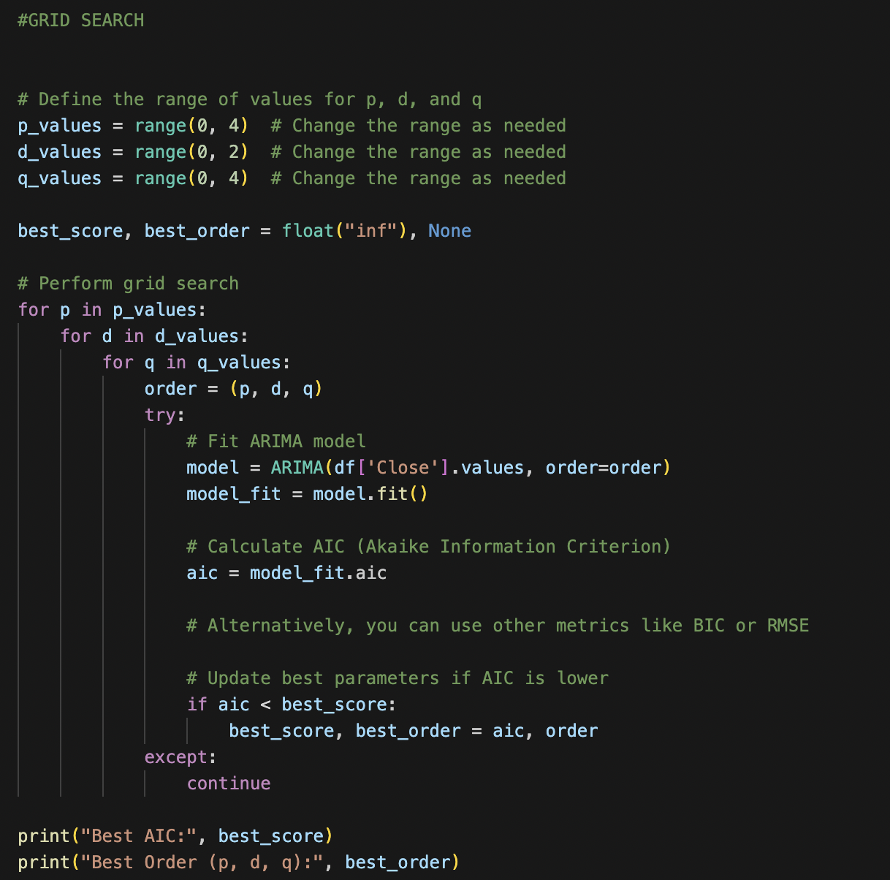
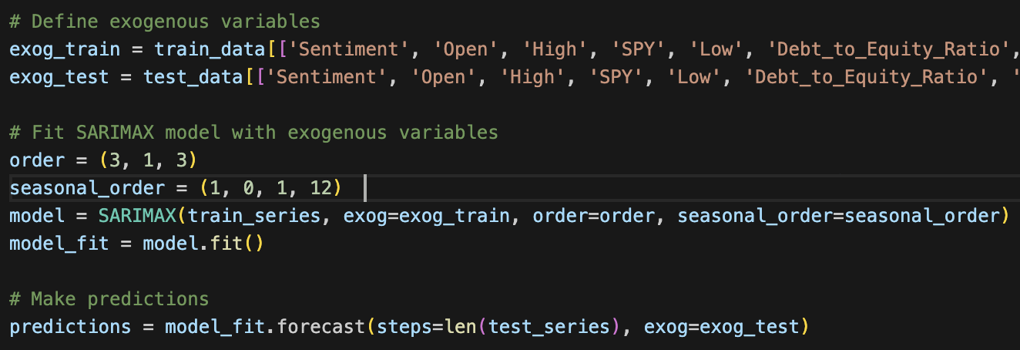
Time Series Regression
Predicted price:
ARIMA model: 493.12
SARIMAX model (with exogenous variables): 492.19
Parameter tuning:
Grid search to find the best (p, d, q) combination
Notes:
So here is the result of our time series regression model, and this is the predicted closing price for netflix stock
And here we tuned the model parameters by using a grid search
(notes)
p represents the influence of past observations on the current value.
d represents the order of differencing needed to make the time series stationary.
q represents the influence of past forecast errors on the current value.

Slide 13
Neural Network Models

Slide 14
Models Improvement
Incorporating Financial Statements (that contain several financial metrics) into the model
Training the model on NFLX price data over 13 years
Parameter tuning: number of layers, dropout layers
Experimenting with different architecture:
Unidirectional vs bidirectional
GRU vs LSTM
Notes:
Bidirectional models have the advantage of considering both past and future information when making predictions, which can improve performance, but unidiretional simply means info flows from left to right or right to left.
GRU might be better for shorter sequence time series while LSTM can handle longer-term data

Slide 15
Model Structure
4 layers of LSTM/GRU
Final layer: 1 dense layer, 1 neuron
Use of dropout layer when overfitting observed

Slide 16
Summarised Results
Predictions for 24 Jan 2024
Actual closing price: $544.87
layer | pure lstm |  | pure gru |  | pure LSTM + GRU |  | bi lstm |  | bi gru
 | loss | prediction | loss | prediction | loss | prediction | loss | prediction | loss | prediction
512,256,128,64 | 0.0004 | 489.90527 | 0.0008 | 491.21616 | 0.0005 | 488.98505 | 0.0006 | 489.60965 | 0.0005 | 490.71393
256,128,64,32 | 0.0005 | 489.68347 | 0.0005 | 487.37552 | 0.0006 | 490.06396 | 0.0005 | 487.87384 | 0.0005 | 489.0257
128,64,32,16 | 0.0004 | 490.1569 | 0.0018 | 488.10992 | 0.0008 | 485.43457 | 0.0010 | 487.03503 | 0.0006 | 487.5779
64,32,16,8 | 0.0004 | 490.68985 | 0.0006 | 485.71378 | 0.0007 | 485.88293 | 0.0009 | 487.13263 | 0.0009 | 484.4838
32,16,8,4 | 0.0004 | 490.58307 | 0.0009 | 483.55634 | 0.0005 | 488.8563 | 0.0009 | 484.32278 | 0.0010 | 482.6883
Notes:
In general, we see that PURE LSTM performs with lower loss than PURE GRU which ties back to LSTM having the advantage of learning longer-term dependencies and complex patterns
Bi-directional models seem to perform poorer than a unidirectional model, which could mean that

Slide 17
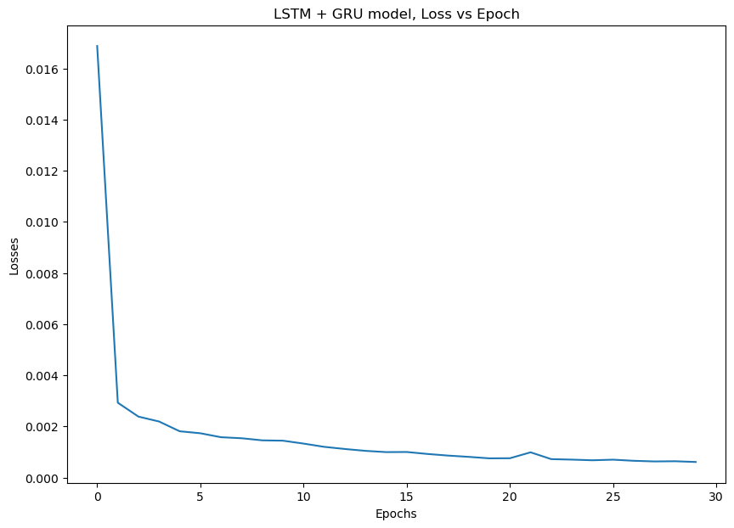
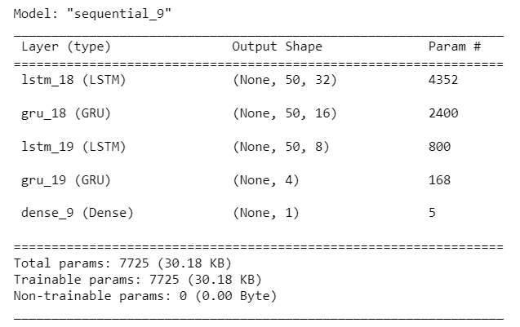
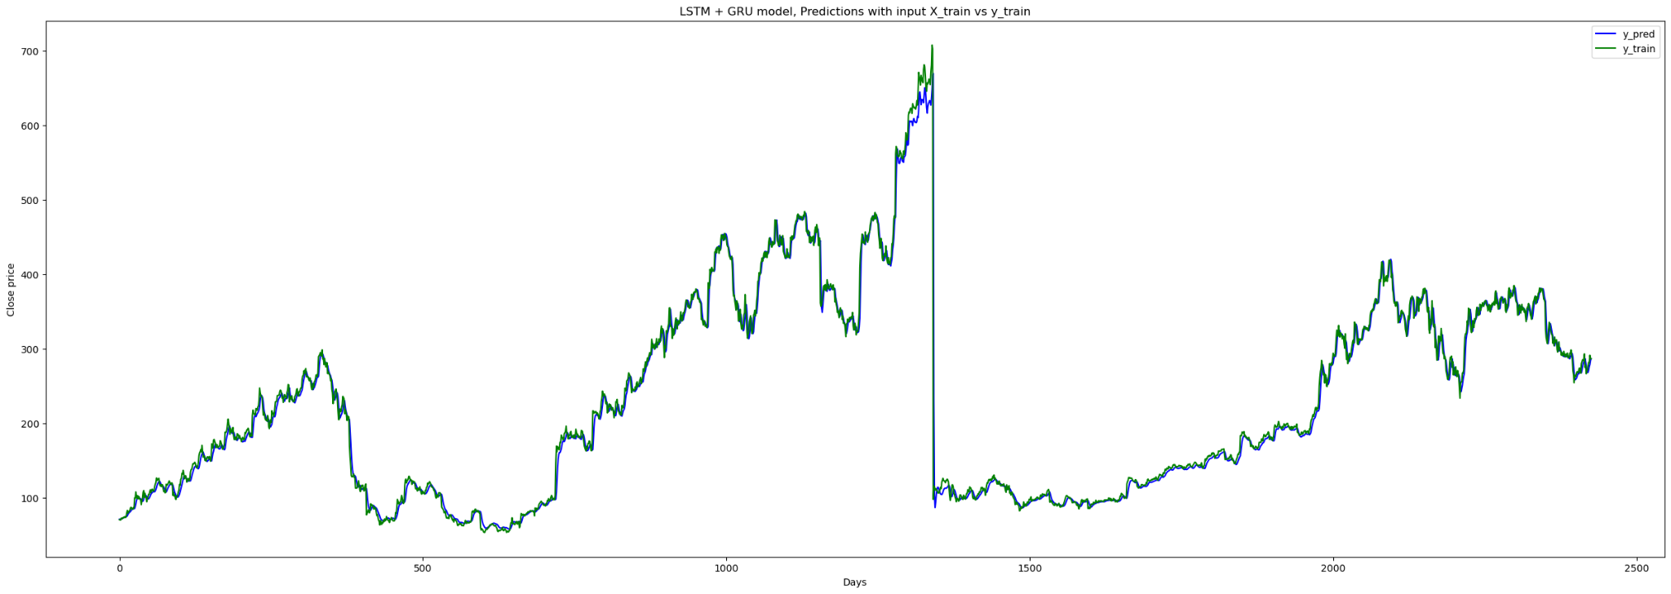
Model Performance: Pure LSTM + GRU
Model 1: 32, 16, 8, 4
Loss: 0.0005
Prediction: 488.98505
Actual: 544.87
Notes:
Starting with a simple model structure of 2 LSTM and 2 GRU layers, and a final dense output layer… the loss returned is much lower than all other models performed.
As seen in the graph plotted, the predicted closing price is also on par with the actual price.

Slide 18
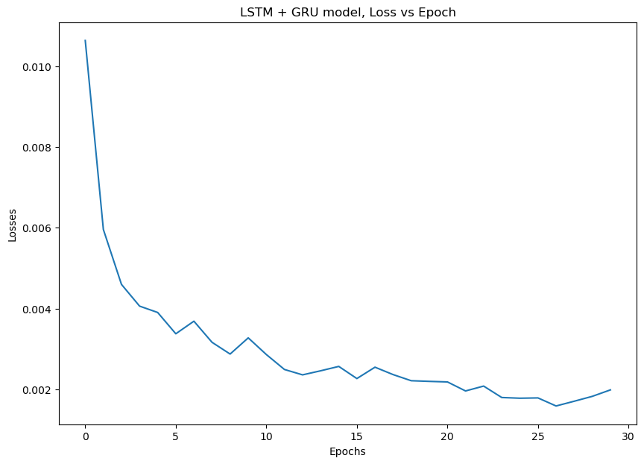
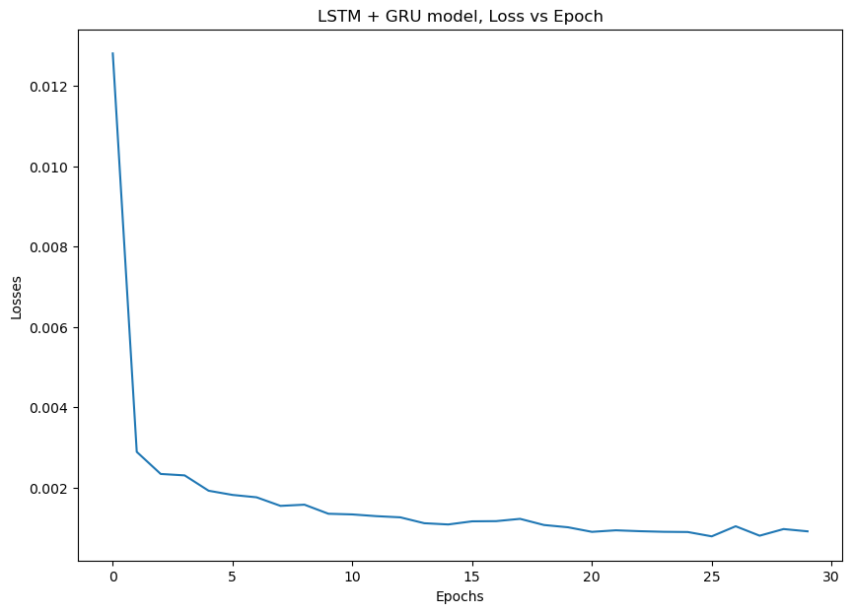
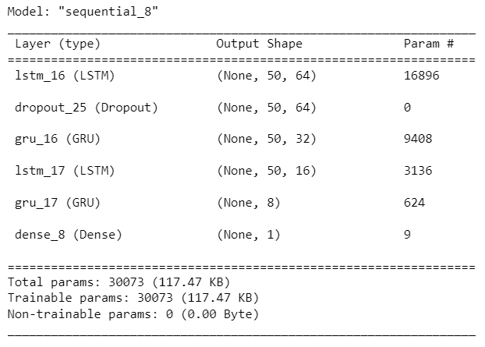
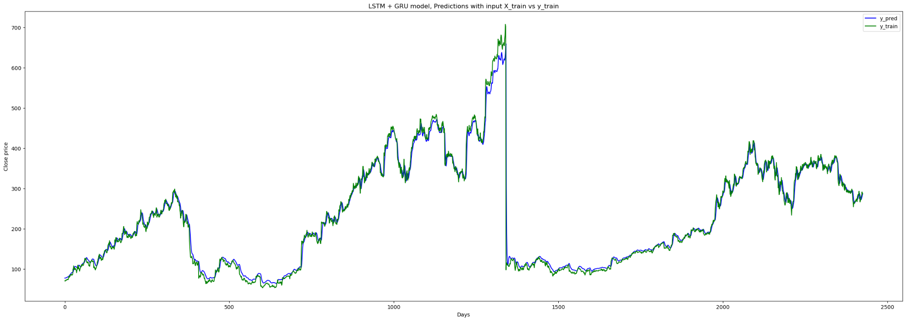
Model Performance: Pure LSTM + GRU
Model 2: 64, 32, 16, 8
Loss: 0.0006 (incr-d)
Prediction: 490.06396
Actual: 544.87
Notes:
Increased the no. of neurons & added a single dropout layer
The loss increased slightly to 0.0006

Slide 19
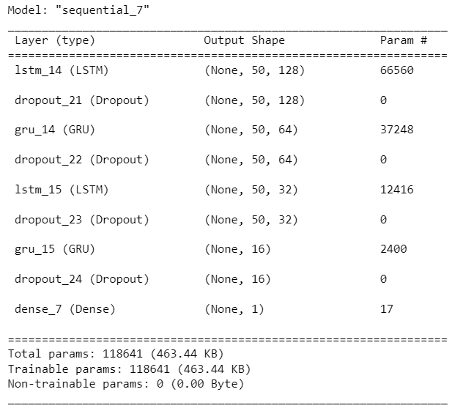
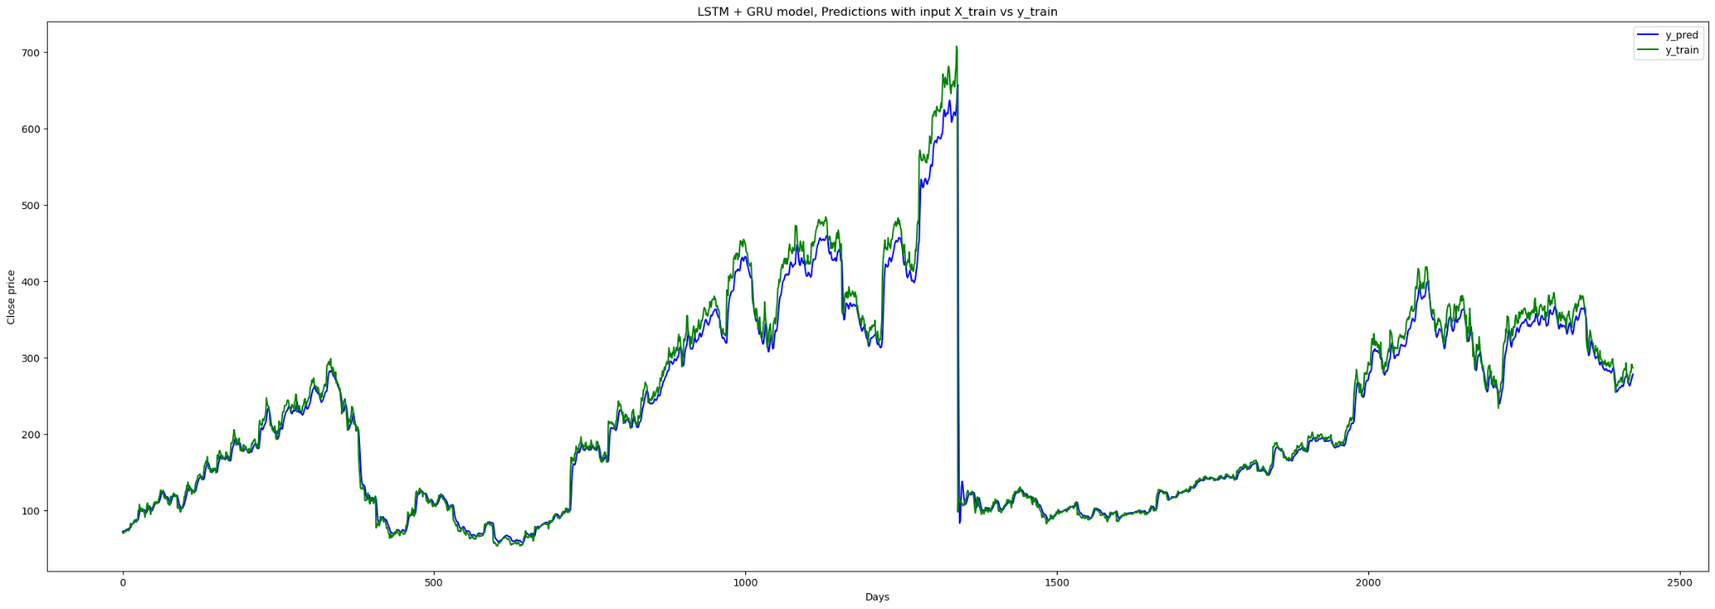
Model Performance: Pure LSTM + GRU
Model 3: 128, 64, 32, 16
Loss: 0.0008 (incr-d)
Prediction: 485.43457
Actual: 544.87
Notes:
Added more dropout regularisation layers after EACH LSTM and GRU layer, also increasing the no. of neurons per layer
But the difference between the y_train and y_pred values are seen to be a lot bigger
The predictions of the closing price EXCEEDS the actual

Slide 20
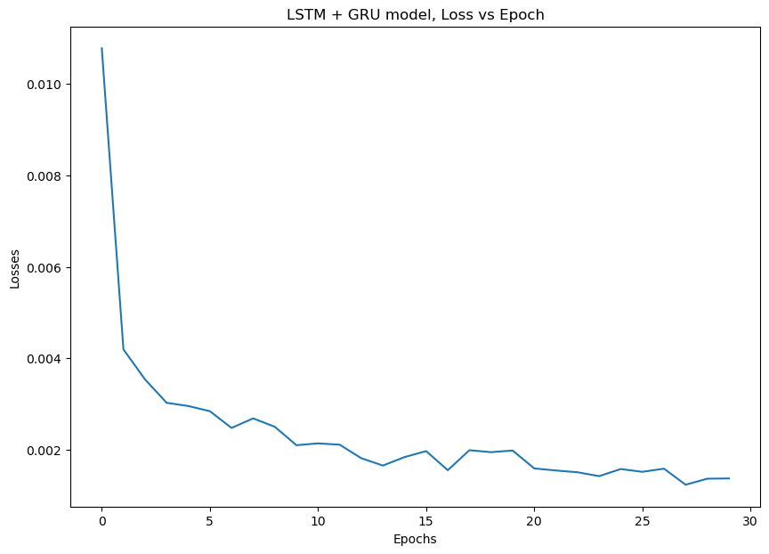
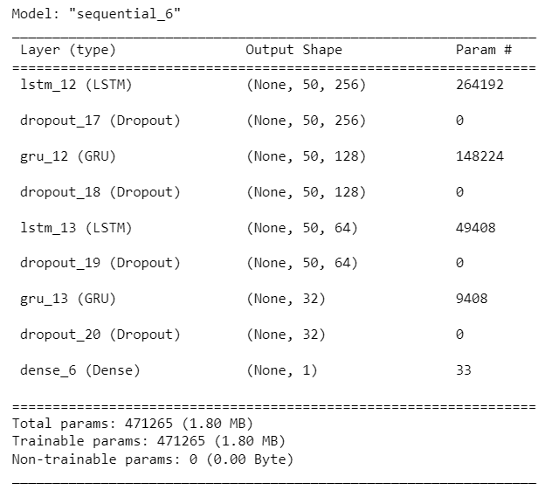
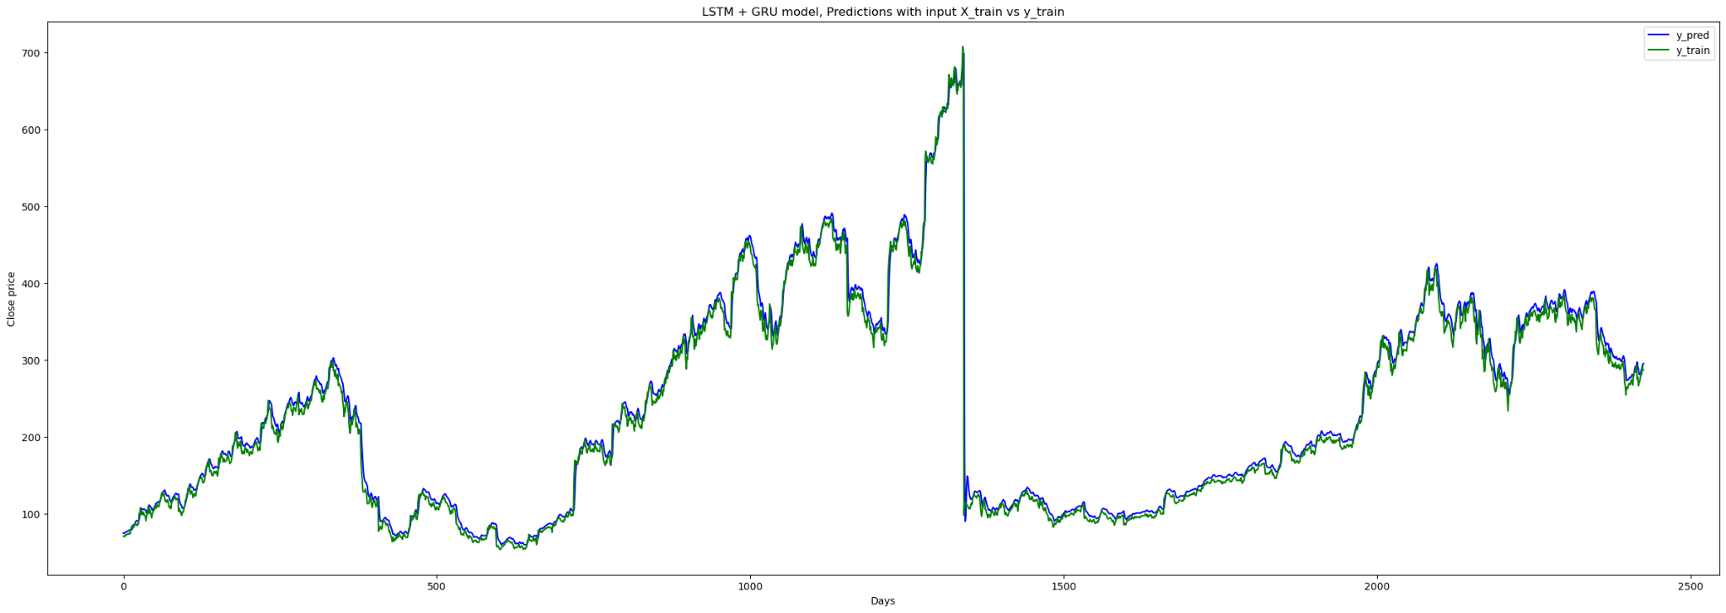
Model Performance: Pure LSTM + GRU
Model 4: 256, 128, 64, 32
Loss: 0.0006 (decr-d)
Prediction: 490.06396
Actual: 544.87
Notes:
Since our prediction wasn’t getting very close to the actual next-day price of $544, we further increased the model complexity

Slide 21
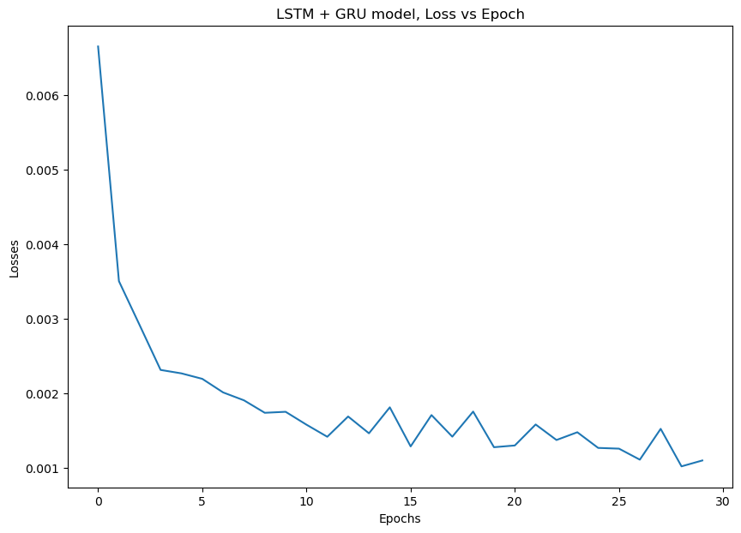
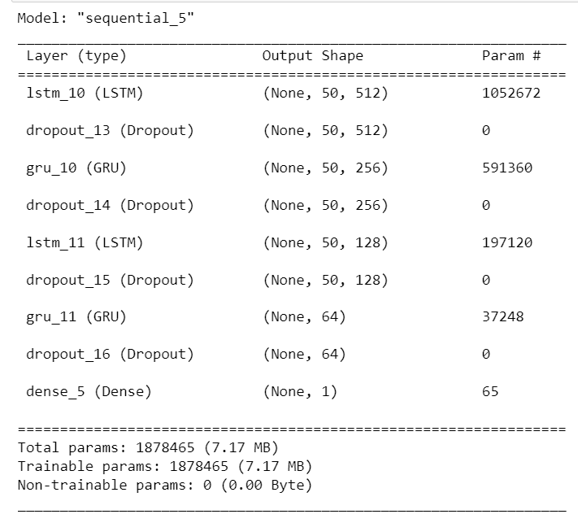
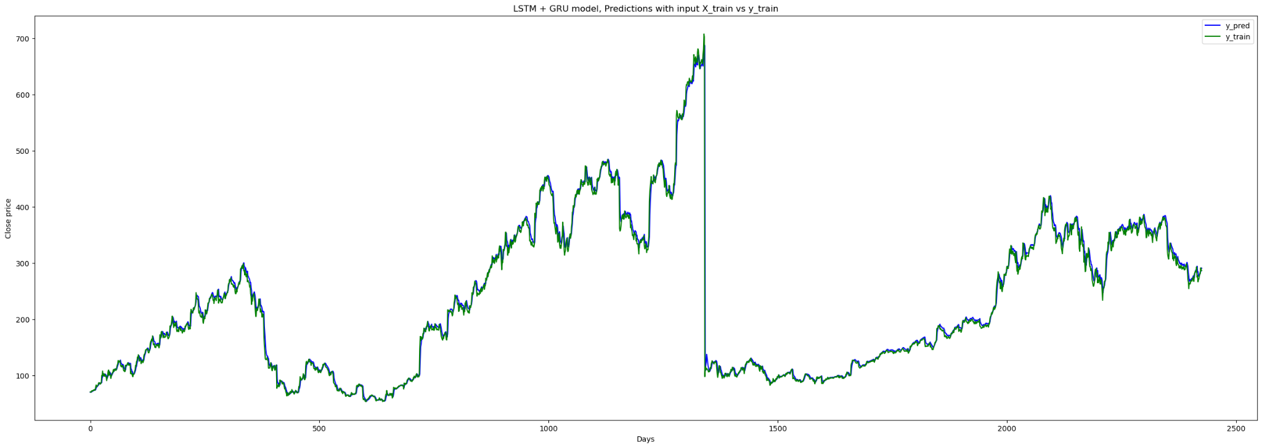
Model Performance: Pure LSTM + GRU
Model 5: 512, 256, 128, 64
Loss: 0.0005 (decr-d)
Prediction: 488.98505
Actual: 544.87
Notes:
Finally, with a model structure as such, the loss returned is minimal and the predicted closing price performs relatively in par with the training data

Slide 22
Final Model:
Choice: Pure LSTM + GRU
Performance:
Loss: 0.0005
Prediction: 488.98505
Problem:
Fluctuation and unpredictability in the stock market

Slide 23
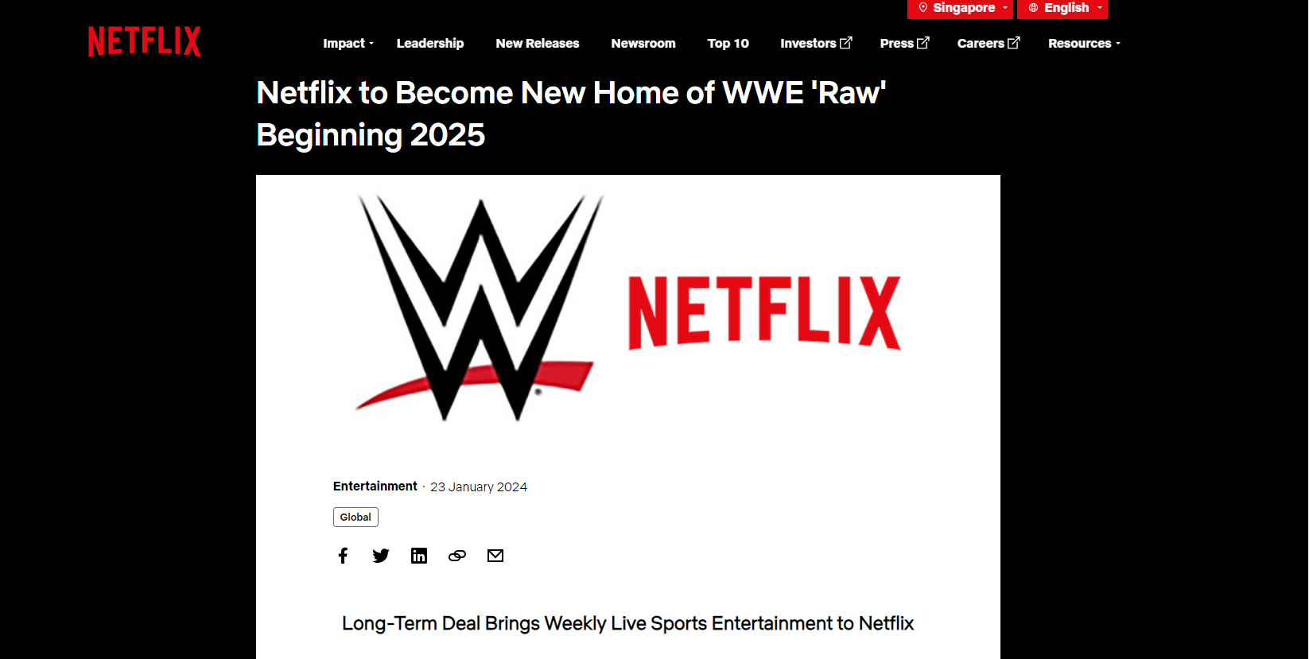

Slide 24
Challenges and Learning Points
Data Scraping
Tedious data cleaning and pre-processing
Experimenting with various, unfamiliar models
Fine-tuning machine learning models
Unfamiliar financial terms

Slide 25
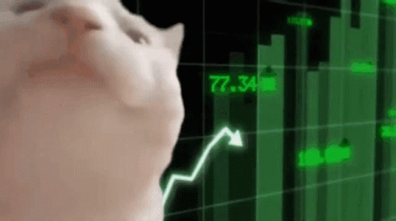
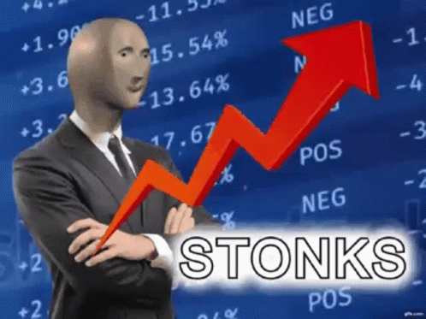
Thank you!

